Slide 1
EHC

Slide 2

EHC IS AN APPLICATION SOFTWARE WHICH IS PROVIDING HEALTHCARE FACILITIES THROUGH DIGITAL MEDIA PLATFORM. IT WILL KEEP AN EYE ON THE PATIENT’S CONDITIONS AND PROGRESS THROUGHOUT THE DURATION OF THE TREATMENT. THESE SERVICES WILL STORE THE PATIENT’S MEDICAL TEST REPORTS, WHICH DOCTORS CAN ACCESS ANYTIME THEY WANT.
WHO THE BRAND IS?

Slide 3
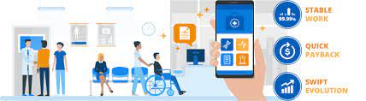
MISSON OF EHC
OUR MISSION OF OUR PROJECT IS TO SERVE THE CITIZENS AS SOON AS POSSIBLE EVEN IN TIMES OF AN EMERGENCY, TO HELP THE PEOPLE AROUND THE STATES AND TO BUILD A RELATIONSHIP OF HUMANITY THROUGH OUR APPLICATION. EVERYTHING WILL BE EASILY AVAILABLE TO THE PEOPLE IN ONE TOUCH, THEY DON’T HAVE TO GO OUT OF THEIR WAY FOR ANY KIND OF HELP, THIS APPLICATION WILL REACH OUT TO THEM INSTANTLY AND GIVE THEM RESULTS IN NO TIME.

Slide 4

VISION
OUR VISION IS TO ENSURE THAT EVERY CITIZEN CAN GET THE BEST IN HEALTHCARE BY EACH HEALTHCARE WORKERS AND DEPARTMENTS BY STAYING CONNECTED WITH EACH OTHER.
OUR AIM IS TO BE THE BEST IN HELPING HEALTHCARE WORKERS BY GETTING THEM TO COMMUNICATE WITH EACH DEPARTMENT FOR THE WELFARE AND BETTERMENT OF THEIR PATIENTS. HEALTH IS A STATE OF COMPLETE MENTAL, SOCIAL AND PHYSICAL WELL-BEING, NOT MERELY THE ABSENCE OF DISEASE OR INFIRMITY. IT DOESN'T END THERE; OUR SOLE GOAL IS TO ACHIEVE A BETTER FUTURE IN TREATMENTS AND THE WAY TO MEDICATE PATIENTS.

Slide 5

VALUES
THIS APPLICATION WILL NOT ONLY HELP THE CITIZENS BUT IT WILL ALSO HELP TO MAKE INDEPENDENT SOCIETY BY PROVIDING HIGH QUALITY HEALTH CARE TO ALL. IT WILL HELP THEM TO DETECT THEIR HEALTH ISSUE, TO DO ROUTINE CHECK UP WHENEVER THEY WANT BY TAKING AN APPOINTMENT THROUGH THEIR PHONE. THE ADMINISTRATIVE WILL BE LINKED TO ONE ANOTHER AND THEIR HEALTH DETAILS WILL BE ALL SECURE IN THIS APPLICATION.

Slide 6
AI
MODELS:
1)PATTERN RECOGNITION
2)CLASSIFICATION
3)SEGMENTATION
4)REGISTRATION OF ANATOMICAL STRUCTURES AND LESIONS
ANOTHER MODELS:
DYNAMIC, FUNCTIONAL, PHYSIOLOGIC, AND ANATOMIC IMAGING

Slide 7






TARGETED AUDIENCE
THE TARGETED AUDIENCE IS DOCTOR’S, PATIENT, AMBULANCE, BLOOD BANK AND PHARMACY.

Slide 8

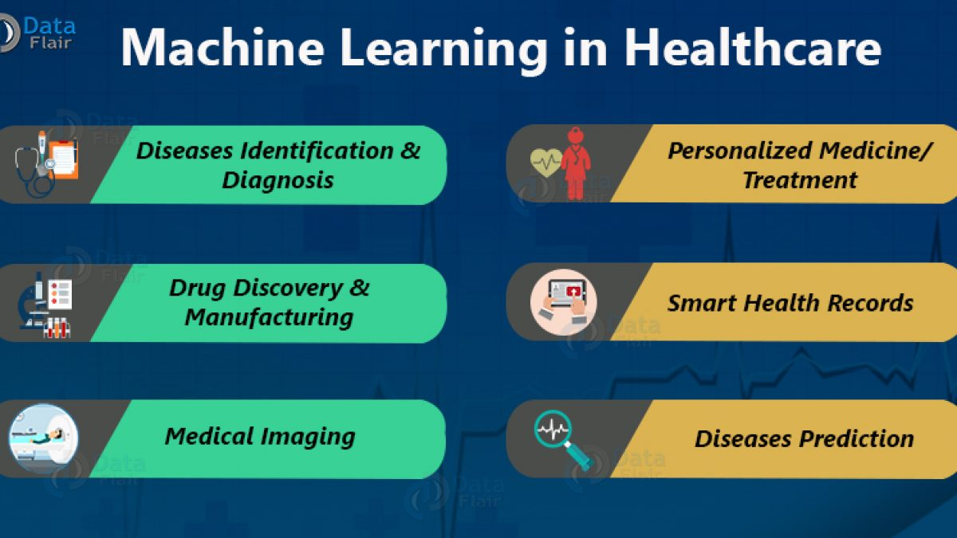
FEATURES
OUR APPLICATION HAS EXCEPTIONAL FEATURES WHICH WILL BRING TREMENDOUS EFFECTS IN PEOPLE LIFE. IT HAS FEATURES LIKE ARTIFICIAL INTELLIGENCE, MACHINE LEARNING, DEEP LEARNING AND NEURO NETWORK ASSISTING IN THE DEVELOPMENT OF TECHNOLOGY LEARNING BY MAKING IT INTERESTING TOOLS TO OUTPUT. E- HEALTH MAY ENHANCE THE QUALITY OF HEALTH CARE BY ALLOWING COMPARISONS BETWEEN DIFFERENT PROVIDERS, INVOLVING ADDITIONAL POWER TO CONSUMERS FOR QUALITY ASSURANCE AND DIRECTING PATIENTS TO THE BEST QUALITY PROVIDERS.

Slide 9

CONTENT MARKETING
THE USER OF THIS APPLICATIONS CAN MAKE THE KNOWLEDGE BASES OF MEDICINES AND PERSONAL ELECTRONIC RECORDS ACCESSIBLE OVER THE INTERNET, E- HEALTH OPENS NEW AVENUES FOR PATIENT CENTERED MEDICINE AND ENABLES PATIENT-BASED MEDICINE CHOICE.

Slide 10
FONT
LORA
OXYGEN MONO
WORK SANS

Slide 11
COLOR PALETTE
2699fa

Slide 12

LOGO
ELECTRONIC HEALTHCARE
ELECTRONIC HEALTHCARE
ELECTRONIC HEALTHCARE
EHC LOGO SHOULDN’T BE WITHOUT ITS FULL FORM “ELECTRONIC HEALTHCARE”
ELECTRONIC HEALTHCARE SHOULDN’T BE WRITTEN ANYWHERE ELSE. IT SHOULD BE IN ITS PROPER PLACE.

